Slide 1
AirStrike Defense
By-
Tanjid Hasan Tonmoy
Sakib Hasan

Slide 2
Outlines
Introduction
Aim of the Project
The game structure(Flow Chart)
How To Play
Main Features
Special Features
Overview
Questions

Slide 3
Introduction
“AirStrike Defense” is a single player game.
This is a 2D shooting game.
Wrote in C and C++ programming language, with the help of Simple and Fast Multimedia Library (SFML - v2.4.1)
Compiled in CodeBlocks (16.01)

Slide 4
Aim of the Project
Implementation of C/C++ language programming.
Learning basic level graphics operations.
Producing something with real life significance.
Use of some basic and advanced technics of programming.

Slide 5
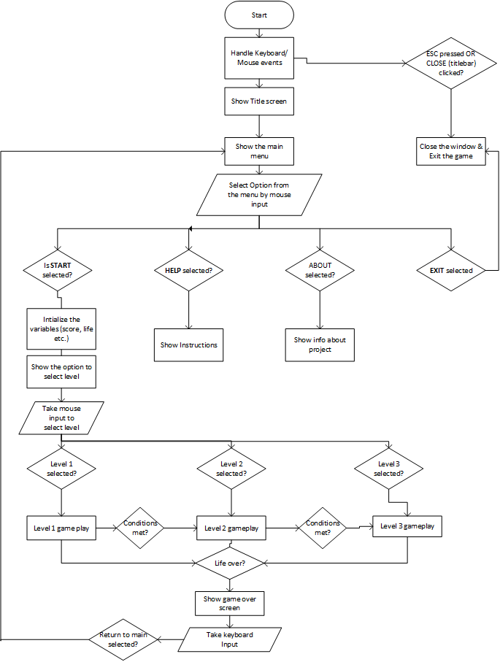
The game structure(Flow Chart)

Slide 6
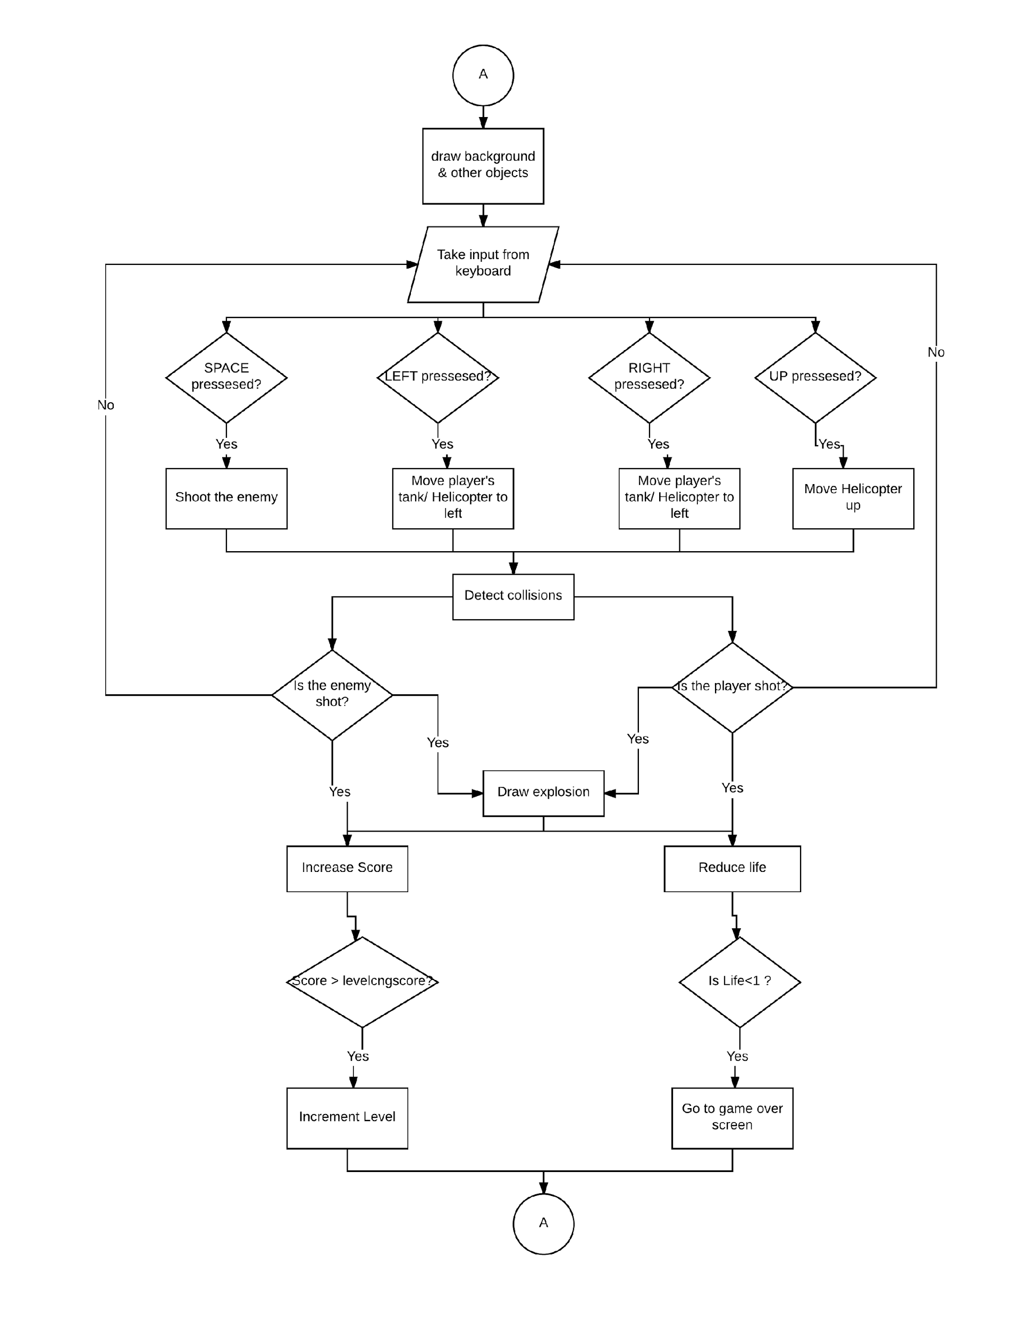

Slide 7
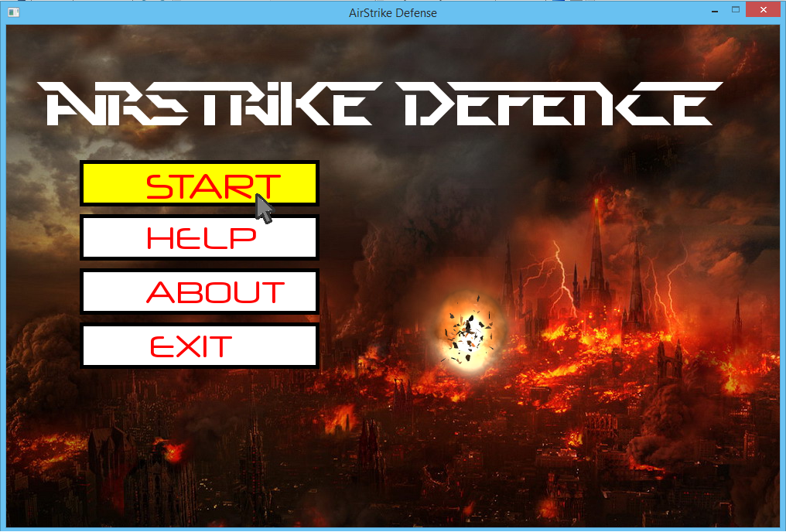
Main Features
Interactive menu - The game has an easy to use, interactive menu which responds to the user’s mouse operations.

Slide 8
Menu Section :
Help and About menu is given.
* Help section will help players to learn about the game and how to play this game.
* About section will introduce the players with the game as well as the developers and project motives.
‘Exit’ button is to quit the game.

Slide 9
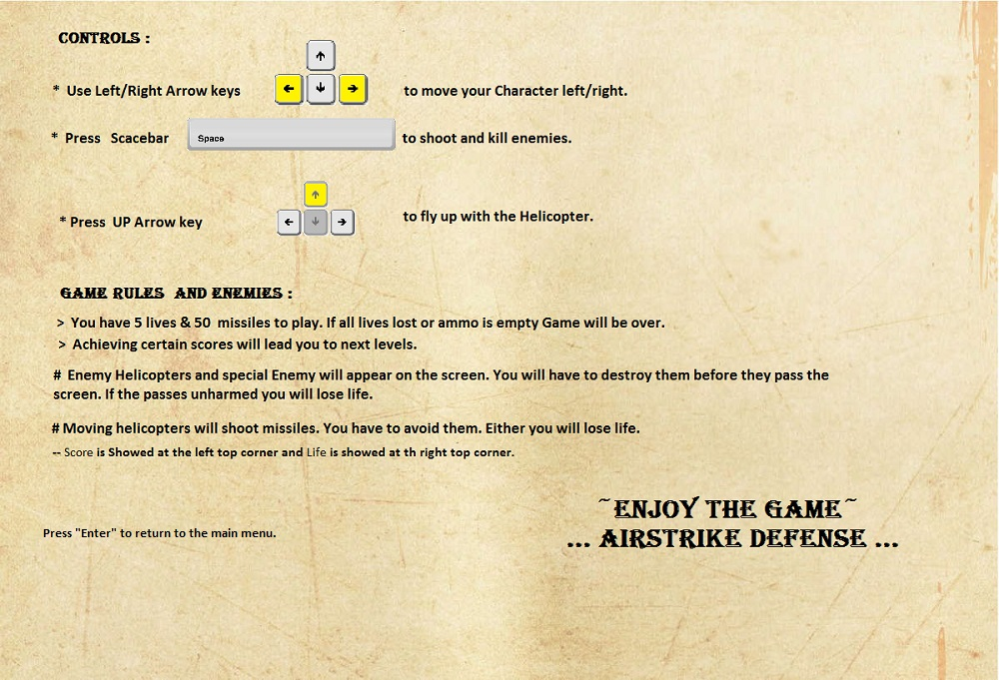
Help Menu(How To Play)

Slide 10
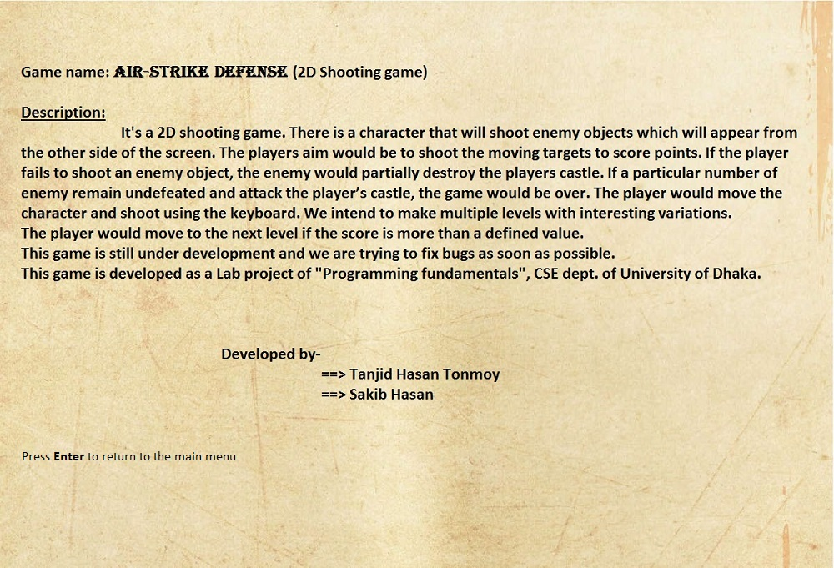
About/Credits

Slide 11
In-game section :
Life and score is simultaneously displayed on the screen.
Multiple Levels added.
Interesting & attractive sprites and backgrounds added.
Shooting and Movements are Keyboard input based.
‘Game Over’ scene will display total score and comments.

Slide 12
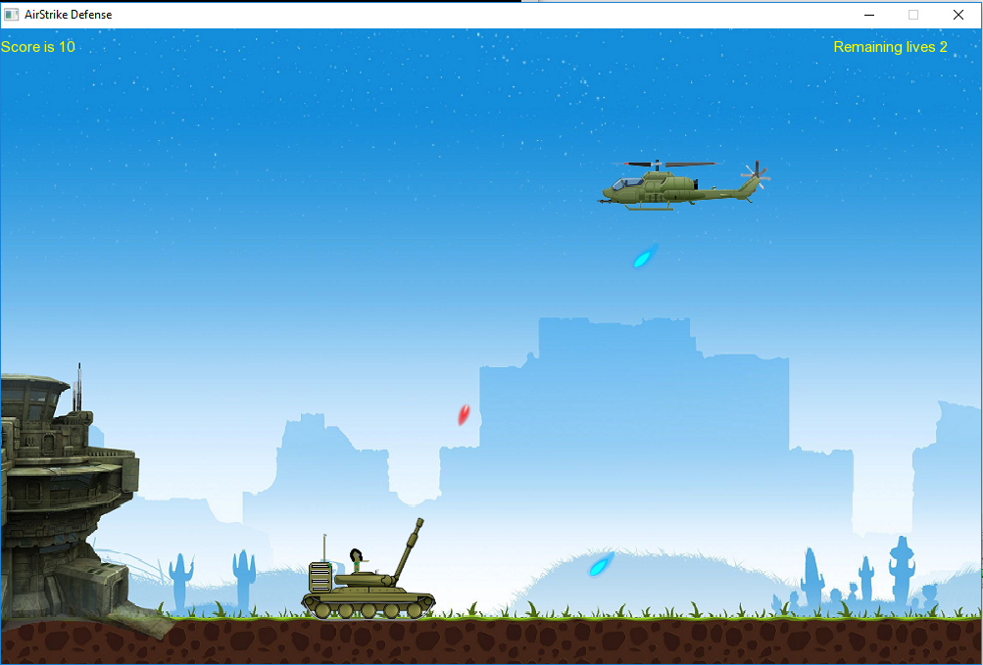
Level - 1
>> Both Tank and Enemy Helicopters move horizontally..
>> Missiles move in a certain angle for difficulty.

Slide 13
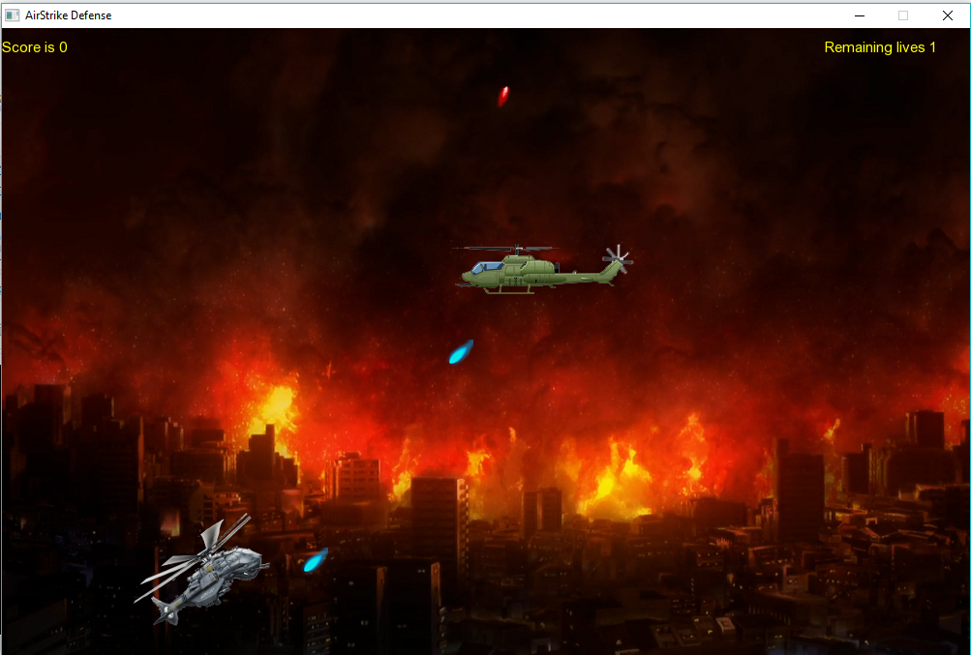
Level - 2
>> Here we used new Character(helicopter) for level 2
>> We added movement against gravity to make helicopter fly.
>> In this Level Enemy doesn’t move only straight line it moves vertically too.

Slide 14
Special Features
Sub-menu added to choose and play certain levels.
Different characters for different levels.
>> Tank – Ground unit
>> Helicopter – Air unit
Explosion graphics added as a visual effect.
Added sound for explosion and shoot for intense feeling and making it realistic
Special Enemy added for last level.
‘Game Over’ scene will also show ‘Highest Score’ till date.

Slide 15
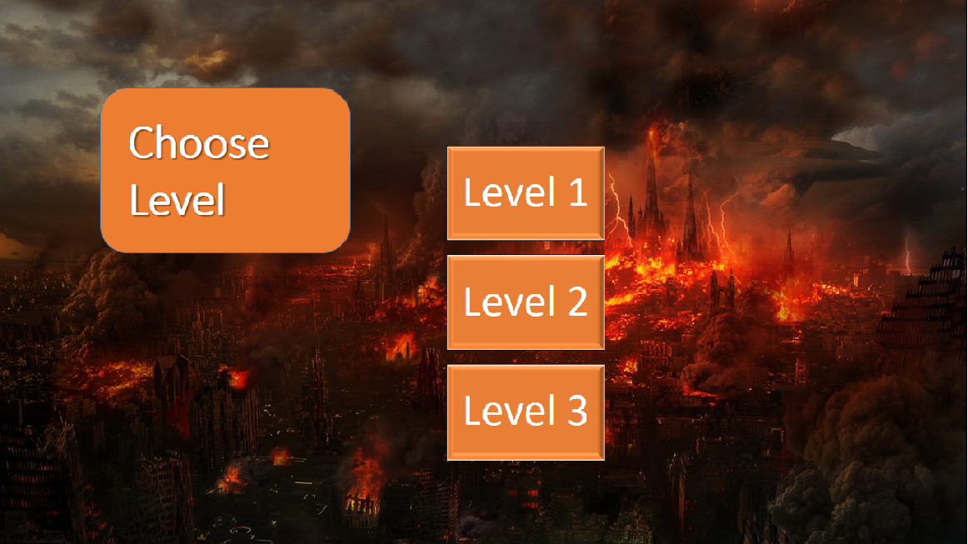
Sub Menu

Slide 16
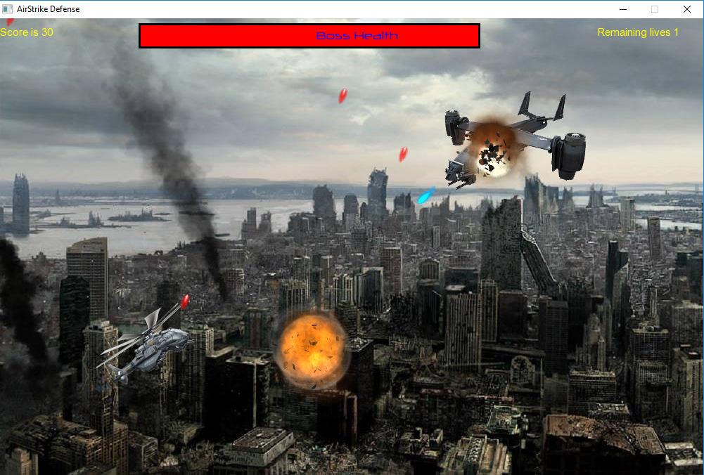
Level 3 !!

Slide 17
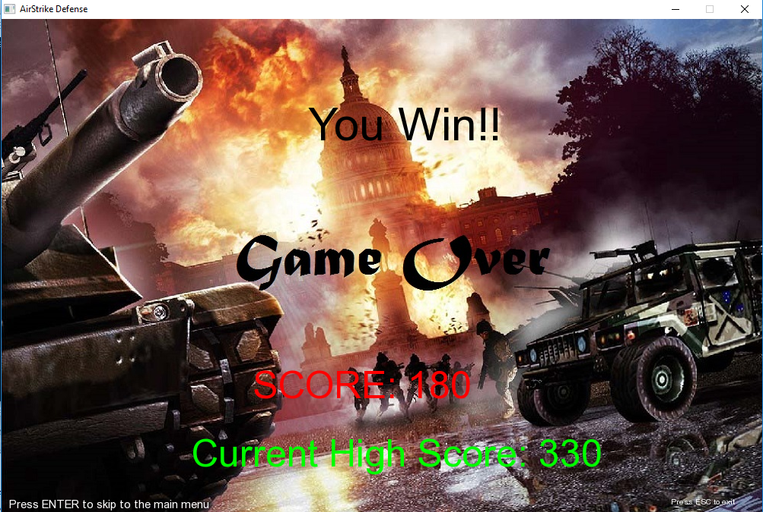
Game Over ☹

Slide 18
Bugs!!
No major bug has been found so far.

Slide 19
Overview
Great project to summarize the students knowledge on C language.
Can influence future game developing.
Our Experience
Working in a project like making a game was really very interesting and we gained much knowledge while building it. Most importantly we developed our structured programming knowledge and this was the first time we wrote such a big code and really was very helpful.
But we faced some problems using SFML. We faced problem in controlling inputs and commands as SFML is still under development.

Slide 20
Thank You…

Slide 21
Questions??

